Slide 1


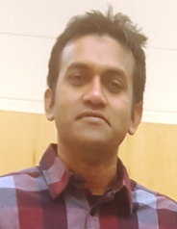


Supporting Source Code Search with Context-Aware and Semantics-Driven Query Reformulation
@masud2336
Masud Rahman, PhD Candidate
Department of Computer Science
University of Saskatchewan, Canada
Advisor: Dr. Chanchal Roy
PhD Defence
Notes:
Hello everyone! Good afternoon! Thanks for attending this meeting.
My name is Masud Rahman. I am a PhD Candidate from Software Research Lab.
I work with Dr. Chanchal K. Roy.
Today, I will be talking about automated query reformulations for code search.

Slide 2
Talk Outline
Part 1: Research Problem
Part 2: PhD Thesis
Part 3: Bug Doctor Demo
Part 4: Q&A + Discussions
Notes:
Today, my talk will be divided into four sections.
In the first section, I will discuss the research problem I am trying to solve in my PhD.
In the second section, I will discuss about my PhD Thesis proposals to solve that research problem.
In the third section, I will summarize my PhD contributions.
Finally, we will have a Q&A session and interesting discussions.

Slide 3
P1
P2
P3
P4
Part 1: Research Problem
Notes:
Part 1: Research Problem

Slide 4
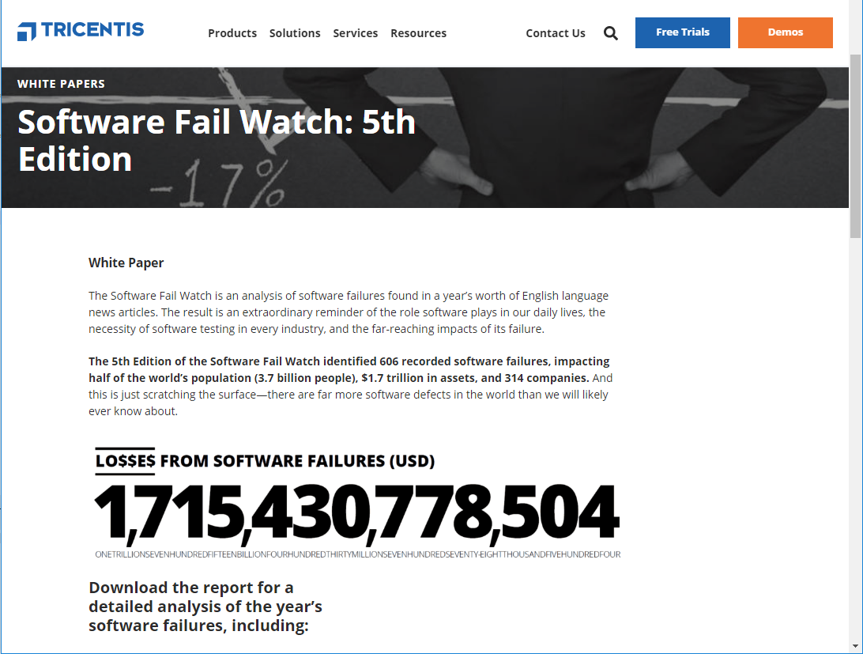

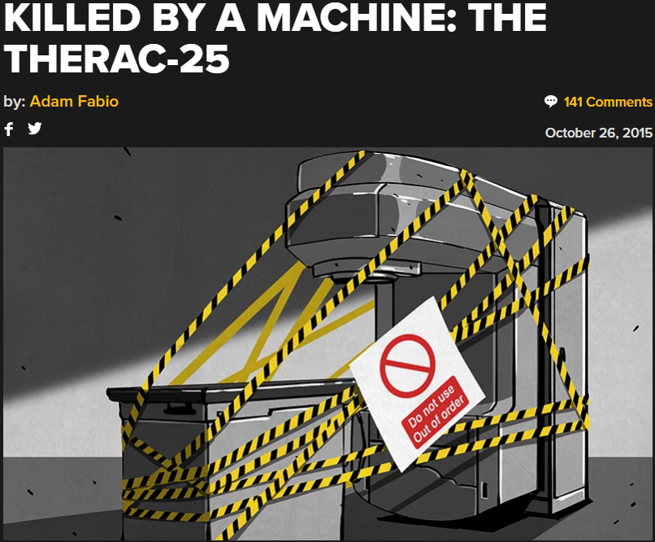
P1
P2
P3
P4
Story I
Software Bugs

Slide 5
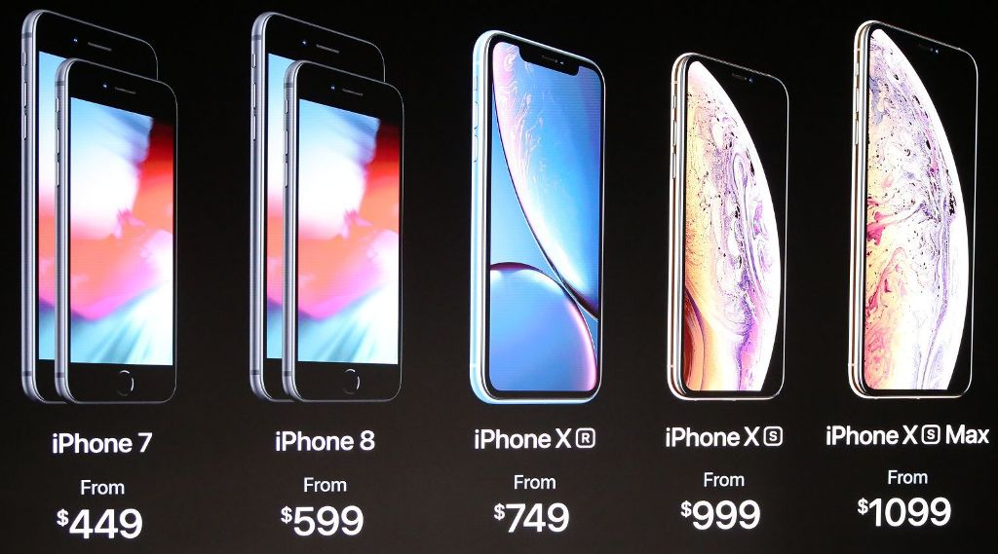

P1
P2
P3
P4
Story II
Software Features

Slide 6




P1
P2
P3
P4
Story III
20%
60%
Bug Resolution
Feature Enhancement
Software Features
Software Bugs

Slide 7
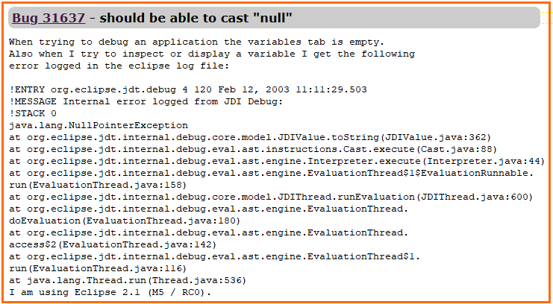


An Example Bug Report & Bug Localization
P1
P2
P3
P4
Bug Localization

Slide 8

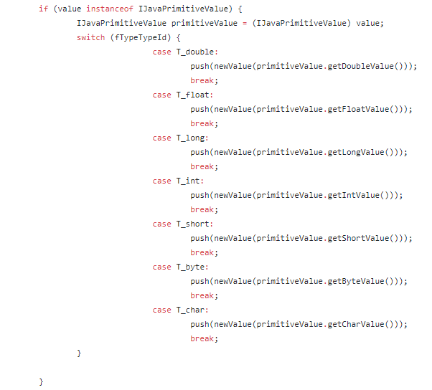

Search Query Reformulation for Bug Localization
127 Words
53
Keyword
selection
Research Problem-I
1
JDIValue, toString, execute, EvaluationThread, run, NullPointerException able cast null

Slide 9
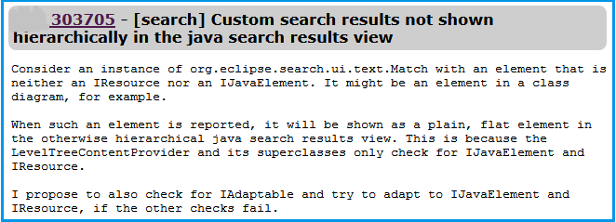
An Example Change Request & Concept Location
P1
P2
P3
P4
Concept Location

Slide 10
Search Query Reformulation for Concept Location
14
56 Words
Keyword
selection
Research Problem-II
1
element IResource Level Tree Provider

Slide 11


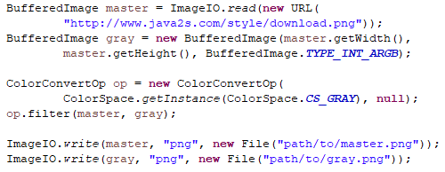
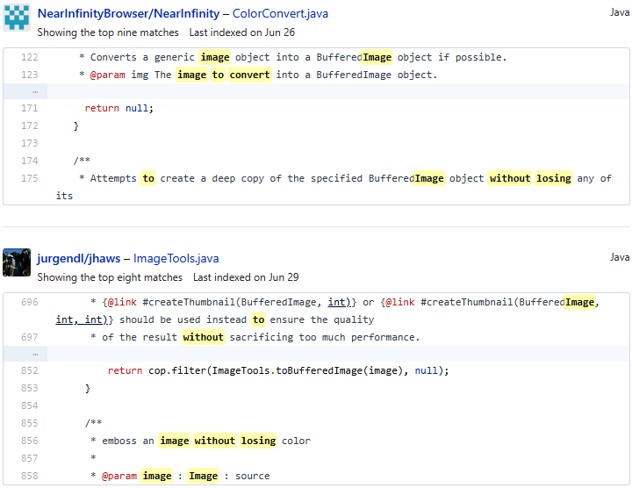
Relevant Code Search on the Web
P1
P2
P3
P4
Convert image to gray scale without losing transparency
Research Problem-III
BufferedImage Grayscale ImageEdit ColorConvertOp File Transparency ColorSpace BufferedImageOp Graphics ImageEffects
Notes:
Now, I am not going to discuss those studies in details.
But here is the glimpse.
Developers generally look for relevant code on the web using natural language query.
Please note that we are not talking about simply web search, rather talking about source code repository such as GitHub.
Now, GitHub provides this result. Now, you see it tries to match the query keywords with comment and identifiers.
But what we are dealing with source code right? So, we need source code friendly query for a better result.
So, we identify relevant API classes against this natural language query through extensive data mining and data analytics.
And once again, Stack Overflow is our friend in this grand challenge.

Slide 12


Part 1: Summary
P1
P2
P3
P4
(1) Bug Localization
(2) Concept Location
73%-88%
(3) Code Search on the Web

Slide 13

P1
P2
P3
P4
Part 2: PhD Thesis
Notes:
Now, we are done with Background concepts, Part 1.
Now, we are going into Part 2 -- PhD Thesis

Slide 14

Systematic Literature Review
P1
P2
P3
P4
Query reformulation, query expansion, query reduction, query formulation, query refinement, automated query expansion, AQE, query suggestion, query recommendation, term selection, query replacement, query difficulty, query quality, keyword selection, keyword extraction, search term identification, search query, search term, and search keyword.
ACM DL
CrossRef
DBLP
Mendeley
Initial
results
Google Scholar
Impurity
removal
Filter by
Title
2871
2317
562
IEEE Xplore
ProQuest
Filter by
Abstract
ScienceDirect
56
93
195
SpringerLink
Filter by
Full texts
Merging &
Duplicate
removal
Area of Improvement
Web of Science
Primary
studies
Wiley Online Lib
Notes:
So what we did? We did a systematic literature survey using 56 primary studies on query reformulation for code search.
During this study, we found 3 major issues in the literature.

Slide 15
PhD Thesis Overview
P1
P2
P3
P4
S₁ (STRICT)
(1) Concept Location
S₂ (ACER)
S₃ (BLIZZARD)
(2) Bug Localization
S₄ (BLADER)
S₅ (RACK)
(3) Internet-scale Code
Search
S₆ (NLP2API)

Slide 16
P1
P2
P3
P4
BLIZZARD
Search Query Reformulation for Bug Localization using Report Quality Dynamics & Graph-based Term Weighting
[ESEC/FSE 2018]

Slide 17





Bug Report Quality: A Closer Look
P1
P2
P3
P4
5000+
Noisy
Poor
Rich
Notes:
We did an empirical study with 5K+ bug reports in our ICSE poster.
And we discovered that bug reports could be very different in terms of quality.
There could be different types of bug reports.
It could be noisy with stack traces which is 16%
It could be really poor that does not contain any structured entities, which is 30%
Or it could be rich bug reports that include source code, test case and other stuffs, which is 54%

Slide 18
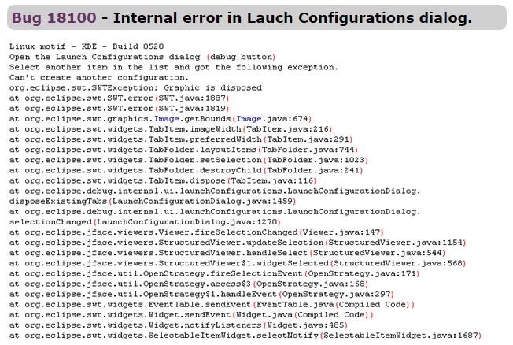

A NOISY BUG REPORT
Stack traces
500 keywords
Too many signals

Slide 19
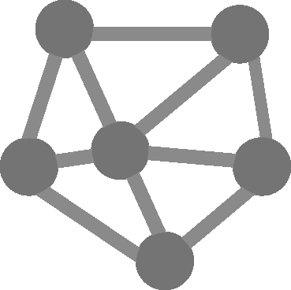
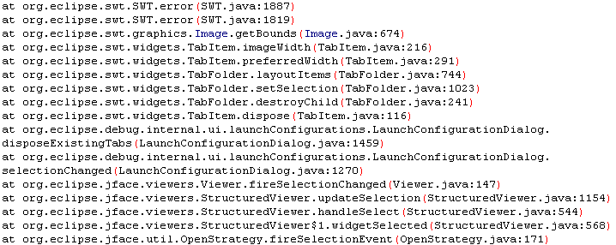
Step I: Trace Graph Construction
P1
P2
P3
P4
P_{i}
C_{i}
Static
M_{i}
i entry
Hierarchical
P_{j}
C_{j}
Static
M_{j}
j entry
I
Notes:
Now, each trace will contain three piece of information – a package name, a class name and a method name.
We know that, in a single line, the method and class are statically connected for sure.
However, classes and methods are also hierarchically dependent across trace lines due to caller-callee relationships.
We capture such static and hierarchical relationships from consecutive trace lines, and develop a trace graph like this.

Slide 20
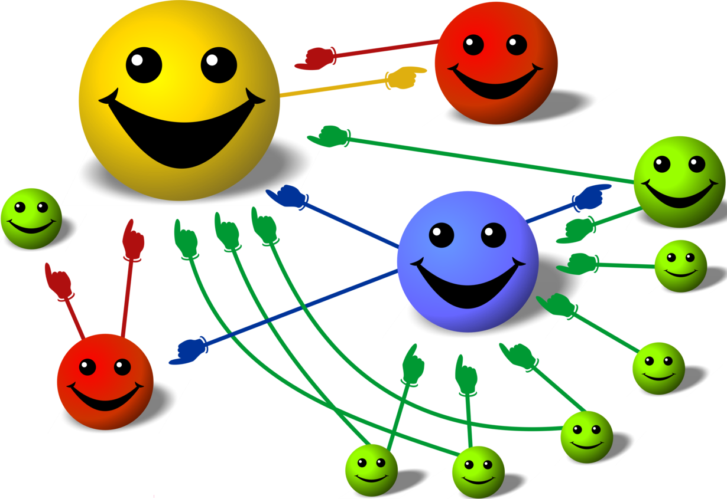
Step II. Search Keyword Selection from Trace Graph
P1
P2
P3
P4
PageRank
Algorithm
C_{i}
C_{j}
M_{k}
M_{n}
II
C_{p}
Notes:
So, we have created two graphs, right?
Now, we have two graphs developed from the bug report based on two different dimensions
--Word co-occurrence and syntactic dependence.
Once we have graphs, we apply this famous algorithm called PageRank algorithm. This is the backbone of Google search.
Now, the algorithmic details are a bit complex, but I will try to provide an overview here.
Why do you think, this guy is laughing? Because, it is getting the maximum votes.
Similarly, in the graph, the node that is connected to most of the nodes is the winner.
That is, a term’s importance will be determined by its connectivity with other nodes.
More importantly, since this is a recursive algorithm, the importance depends on the weights of the connected node as well.
Once the computation is done, we get a reformulation candidate from each graph.
What is the reformulation candidate? – a ranked list of keywords like this.
So, we collect two candidates from two graph, apply machine learning and suggest the best one as our suggested query from the bug report.

Slide 21



Search Query from a Noisy Bug Report
P1
P2
P3
P4
Bug 31637 – should be able to cast null
NullPointerException
C_{i}
C_{j}
M_{k}
M_{n}
C_{p}
53
01
Notes:
So, from a noisy report, we extract
The report title
The encountered exception
The most important keywords from the stack traces.
Then we do the search with this newly constructed query.
For example, the baseline noisy query returns the result at 53rd position.
Whereas our query returns the correct result at the topmost position.

Slide 22
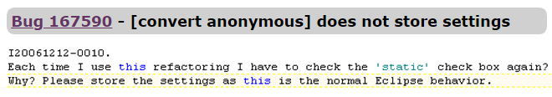
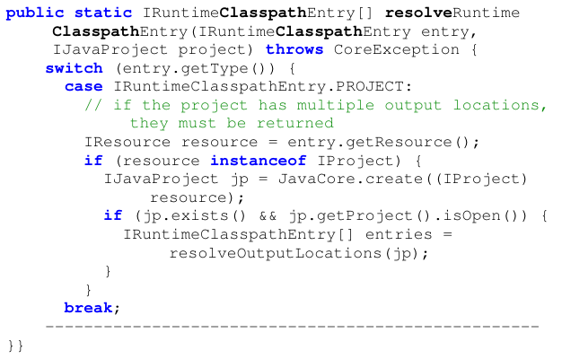
A POOR BUG REPORT
No signal
15 keywords

Slide 23
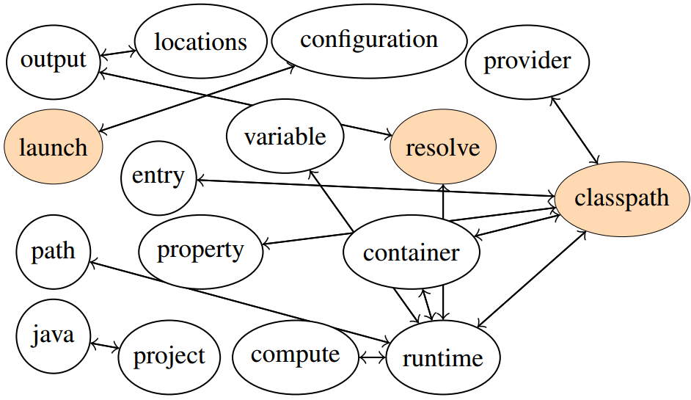

Search Keywords from Source Code
P1
P2
P3
P4
launch
debug
resolve
required
classpath
resolveRuntimeClasspathEntry
Resolve Runtime Classpath Entry
Notes:
Now once such items are extracted, we split them.
Now as we see, these single terms share some kind of semantics to convey a broader semantic.
That is, they complement each other in this context.
Now, we capture such semantic dependencies in the source code, and develop a term graph like this.

Slide 24
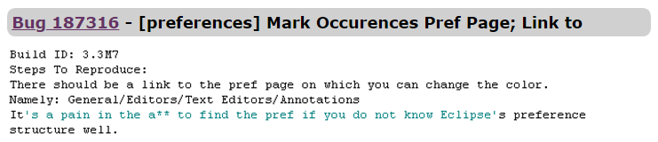
Search Query for a Poor Bug Report
P1
P2
P3
P4
30
compliance create preference add configuration field dialog annotation
01
Notes:
In the case of poor bug report, we also apply a similar PageRank approach.
But we collect the keywords from the source code using pseudo-relevance feedback.
The details can be found in the paper.
So, the bug report texts are merged with the keywords from relevant source code.
While the bug report texts return the result at 30th position.
After feeding poor report with appropriate keywords, the correct result is returned at the top most position.

Slide 25
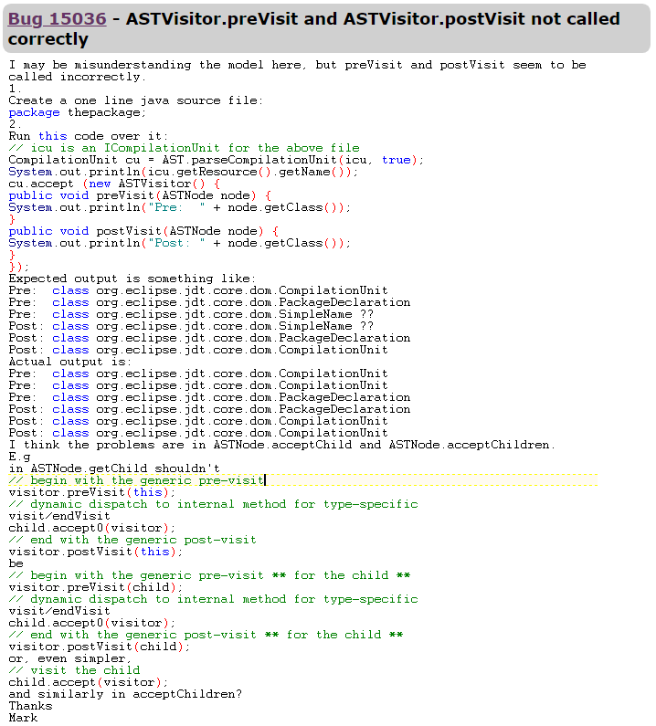
A RICH BUG REPORT
27
195 keywords
astvisitor post postvisit previsit pre file post pre astnode visitor
01

Slide 26


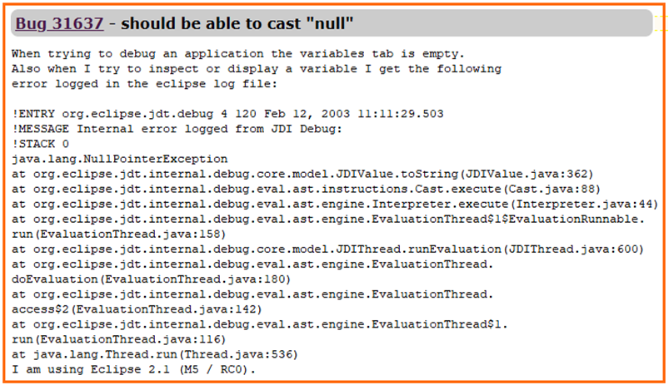
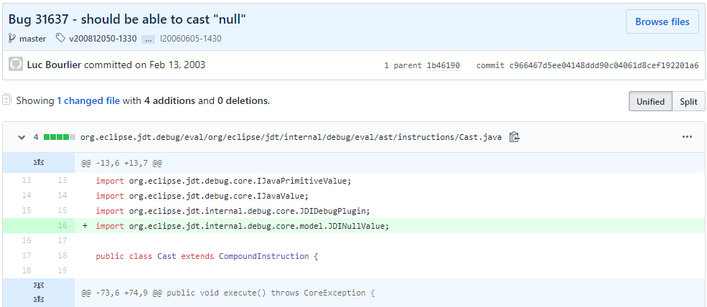





Experiment, Dataset & Metrics
P1
P2
P3
P4
Hit@K
MAP@K
MRR@K
QE
4 RQs
5K+ Bug Reports
Ground Truth
Version History
Notes:
Now, for the experiments, we chose 8 subject systems from Apache and Eclipse.
We collect about 3000 bug reports, and try to map them with the version control history at GitHub.
Through such mapping we extract the ground truth for the bug reports.
This is a standard process followed by the existing literature.

Slide 27
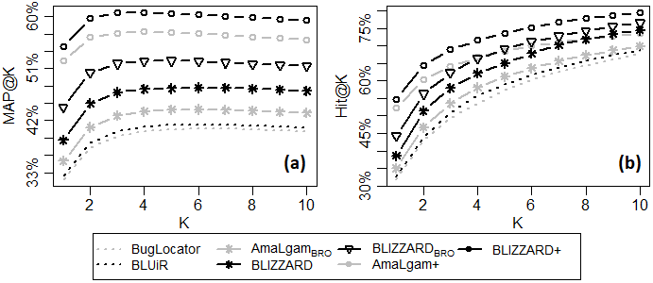
Comparison with the State of the Art (MAP & Hit@K)
P1
P2
P3
P4

Slide 28
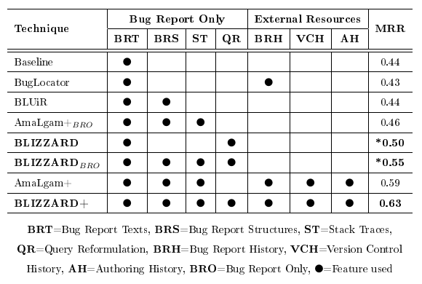
Comparison with the State of the Art (Theoretical)
P1
P2
P3
P4
Promising Dimension

Slide 29

Part 2: Summary
P1
P2
P3
P4
(2) Concept Location
(1) Bug Localization
73%-88%
(3) Internet-scale Code Search

Slide 30
Part 2 Summary: Search Query for Bug Localization
127 Words
53
BLIZZARD
Research Problem-I
Keyword
selection
BLADER
1
JDIValue, toString, execute, EvaluationThread, run, NullPointerException able cast null

Slide 31
Part 2 Summary: Search Query for Concept Location
14
56 Words
STRICT
Keyword
selection
ACER
Research Problem-II
1
element IResource Level Tree Provider

Slide 32
Part 2 Summary: Search Query for Code Search on Web
Convert image to gray scale without losing transparency
RACK
Research Problem-III
NLP2API
BufferedImage Grayscale ImageEdit ColorConvertOp File Transparency ColorSpace BufferedImageOp Graphics ImageEffects
Notes:
Now, I am not going to discuss those studies in details.
But here is the glimpse.
Developers generally look for relevant code on the web using natural language query.
Please note that we are not talking about simply web search, rather talking about source code repository such as GitHub.
Now, GitHub provides this result. Now, you see it tries to match the query keywords with comment and identifiers.
But what we are dealing with source code right? So, we need source code friendly query for a better result.
So, we identify relevant API classes against this natural language query through extensive data mining and data analytics.
And once again, Stack Overflow is our friend in this grand challenge.

Slide 33
P1
P2
P3
P4
Part 3: Bug Doctor Demo
Notes:
Now, we are done with Background concepts, Part 1.
Now, we are going into Part 2 -- PhD Thesis

Slide 34

P1
P2
P3
P4
Part IV: Q&A
Masud Rahman
http://www.usask.ca/~masud.rahman
https://github.com/masud-technope
Contact: masud.rahman@usask.ca
@masud2336
Notes:
Thanks for your time and attention.
Now, I am ready to take your questions.

Slide 35
PhD Contribution Summary
BLADER
STRICT
Bug Localization
Graph-based
Term weighting
BLIZZARD
ACER
RACK
NLP2API

Slide 36

Step I: Extract Trace Entries
P1
P2
P3
P4
S1
S2
S3
S4
S5
S6
i
j
I
Notes:
Now, lets go a bit deeper with this.
From a noisy bug report, we first extract the stack traces.
It might contain hundreds of traces like this.
We choose any two consecutive traces. Lets call them I and J

Slide 37


One Size Does NOT Fit All
P1
P2
P3
P4
S1
S2
S3
S4
S5
S6
Can everybody watch the game?
Yes
Yes
Yes
Yes
No
Yes
Traditional
Notes:
So, clearly there are different quality levels for bug reports.
Now, what do the existing approaches do?
They do not look at the bug reports or its quality. Rather they apply the same treatment to all.
But one size does not fit all, as you know.
So what we do? We propose a much more balanced way to deal with this.
We prefer equity rather than equality in our treatment to bug reports.
So, here comes our work!

Slide 38
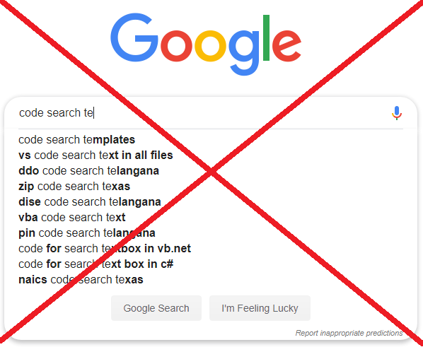









Search for the Buggy Code
P1
P2
P3
P4
*88%
Software Codebase
Bug report
Software
Customer
Code Search
Software Developer
PhD Thesis
Query Reformulation
Query Reformulation
* Kevic & Fritz, ICSE 2014
Notes:
Now, lets say, a Boeing customer has submitted a bug report.
Now, a Boeing developer is responsible to locate and repair the faulty code triggering that bug.
As a frequent practice, developer chooses a few important keywords and attempts to locate the buggy code within the Boeing codebase.
But the study shows that 88% of the keywords chosen by the developer could be incorrect. That is, they do not return the buggy code.
So, the obvious next step is to reformulate the query through automated tool supports, so that the buggy code could be located.
There are also tools that take a bug report and suggest appropriate search queries in the first place.
So, we are interested into these part of the process, and my PhD focuses on this.
As you can also see that, Google does not have any jurisdiction in this case.

Slide 39
Step III: Keyword Selection from Text Graph & POS Graph
P1
P2
P3
P4
S1
S2
S3
S4
S5
S6
PageRank
Algorithm
III
Notes:
So, we have created two graphs, right?
Now, we have two graphs developed from the bug report based on two different dimensions
--Word co-occurrence and syntactic dependence.
Once we have graphs, we apply this famous algorithm called PageRank algorithm. This is the backbone of Google search.
Now, the algorithmic details are a bit complex, but I will try to provide an overview here.
Why do you think, this guy is laughing? Because, it is getting the maximum votes.
Similarly, in the graph, the node that is connected to most of the nodes is the winner.
That is, a term’s importance will be determined by its connectivity with other nodes.
More importantly, since this is a recursive algorithm, the importance depends on the weights of the connected node as well.
Once the computation is done, we get a reformulation candidate from each graph.
What is the reformulation candidate? – a ranked list of keywords like this.
So, we collect two candidates from two graph, apply machine learning and suggest the best one as our suggested query from the bug report.

Slide 40
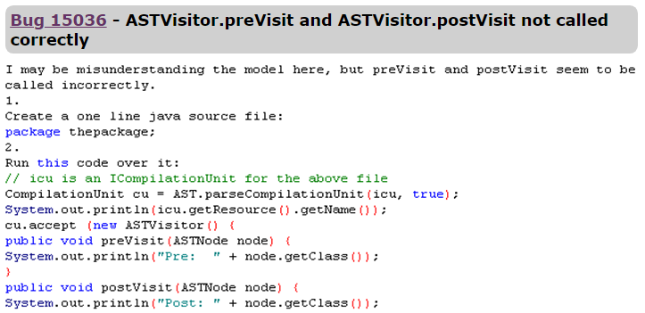


Search Query from a Rich Bug Report
P1
P2
P3
P4
S1
S2
S3
S4
S5
S6
astvisitor post postvisit previsit pre file post pre astnode visitor
Rich Bug Report
27
01
Notes:
The rich bug report is inherently good for IR-based localization.
But we found that selecting appropriate keywords can make it better.
For example, if we reduce the bug report is reduced to these keywords, the correct result comes to the top of the list.

Slide 41
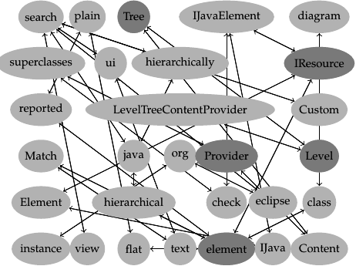
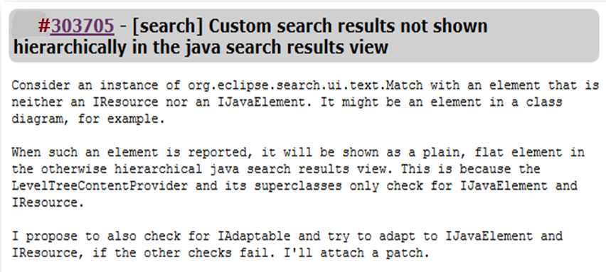
Step I: TextRank Calculation (Mihalcea et al, EMNLP 2004)
P1
P2
P3
P4
S1
S2
S3
S4
S5
S6
(Term Co-occurrence)
IResource … IJavaElement
IResource … IJavaElement
I
Notes:
Similarly, we can see the phrases and dependencies among the terms in the bug report texts as well.
Our job is to identify the keywords from these texts, right?
So, did we do?
We consider the co-occurrences among the terms. That is, how terms occur with other terms within a certain context.
We encode such co-occurrences as edges, and transform the texts into a graph like this.

Slide 42
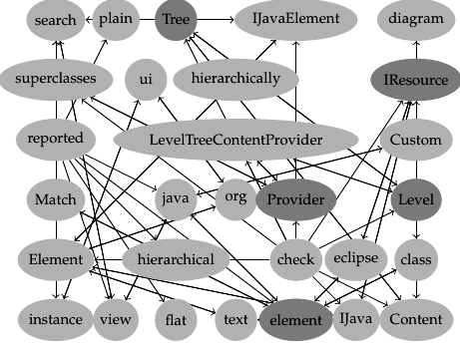
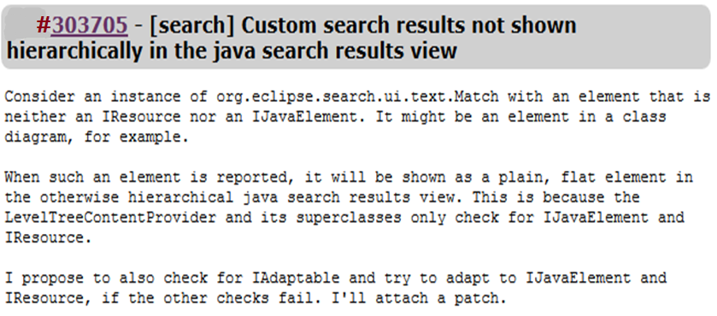
Step II: POSRank Calculation (Blanco & Lioma, Inf. Retr. 2012)
P1
P2
P3
P4
S1
S2
S3
S4
S5
S6
Jespersen Rank Theory (Syntactic Dependence)
(Syntactic Dependence)
Noun
Verb
Adjective
Element …→reported, element …→plain
II
Notes:
Besides term co-occurrences, we consider another aspect called syntactic dependencies.
For this, we used Jespersen Rank Theory, a theory developed back in 1925.
According this theory, parts of speech of sentence can be divided into three ranks –
nouns (first), verbs + adjectives in the second rank and the rest are the third ranks
According to Jespersen, verb and adjective modifies noun. That is there are some syntactic dependencies for between element and reported and element and plain to covey the overall meaning of the sentence.
Now, we capture such syntactic dependencies as well, and transform the report texts into a POS graph as well.

Slide 43

Three Types of Code Search
P1
P2
P3
P4
(1) Bug Localization
(3) Internet-scale Code Search
(2) Concept Location

Slide 44

Search for the Relevant Code
P1
P2
P3
P4
Internet-scale codebase
*76%
Developer
PhD Thesis
Reformulated Query
Query Reformulation
*Bajracharya and Lopes, EMSE 2012
Notes:
So far, we deal with query reformulation for a single codebase.
But you know, besides this local codebase, developers also look for source code in Internet-scale cross domain codebases.
Now, that is a whole new game.
Study shows that developers might fail 88% of the times to retrieve the correct code segments.
So, we did two other studies, and we extensively used Stack Overflow.

Slide 45
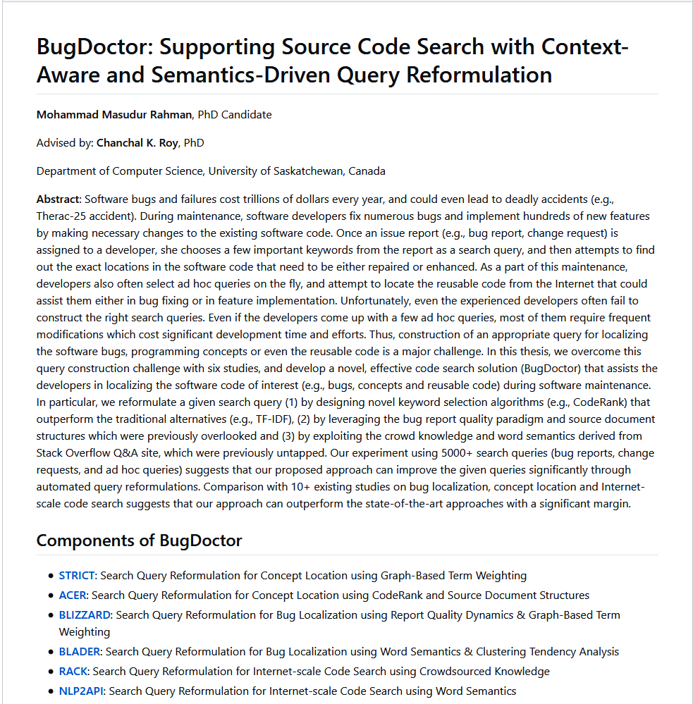

Reproducibility & Replication
P1
P2
P3
P4
https://github.com/masud-technope/BugDoctor
Notes:
Now, I care about the replication and reproducibility of my works in order to grow as a research community.
So, all of works could be replicated and potentially reproduced (hopefully).
I was busy during PhD and my works are uploaded at GitHub.
Many of them are open source.
I am a member of replication workshop and a PC member of replication track, ICPC.

Slide 46

P1
P2
P3
P4
Part III: Future Works
Notes:
Now, how far I would to go in the next 5-10 years?

Slide 47





T1: Bug Reproducibility & Bug Fixing
P1
P2
P3
P4
$1.7
Trillion
Bug Localization
Bug Understanding
Bug Reproduction
Bug Fixing
Notes:
Now, if you remember this diagram.
So far, I focused on Bug Localization in my PhD mostly.
In the next 5 years, I would focus on Bug Understanding and fixing, the next logical steps of software debugging.
Right now, I am working on bug reproducibility.
That is, how to make a reported bug reproducible. Without that, a bug can not be fixed most probably.

Slide 48


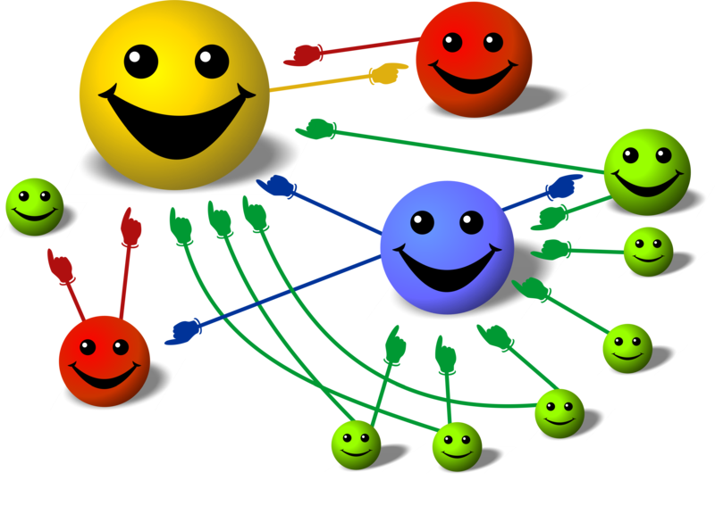
T2: Improved Text Retrieval in Software Engineering
P1
P2
P3
P4
Traditional
20+ SE
Proposed
Notes:
So, I compared between TF-IDF and PageRank.
But so far, I did only for query reformulation.
But there 20+ software engineering tasks that used TF-IDF in one way or another.
Now, a cool thing would be to investigate how PageRank can influence that tasks given PageRank outperformed TF-IDF in query reformulation.
It would be really interesting to see.

Slide 49
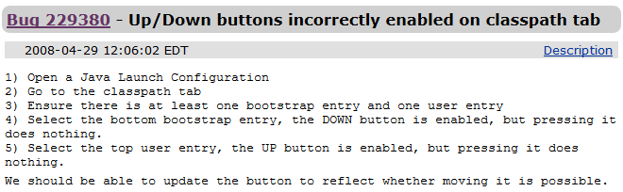
T3: Genetic Algorithm for Queries
P1
P2
P3
P4
Title
Description
Fitness Function
Method | Search Query | QE
Baseline | {title + description} | 25
STRICT[140] | {tab classpath enabled buttons user entry} | 86
TF-IDF | {button entry bootstrap enabled incorrectly moving} | 177
GA | {open reflect tab bottom entry classpath} | 01
Lower QE is better

Slide 50



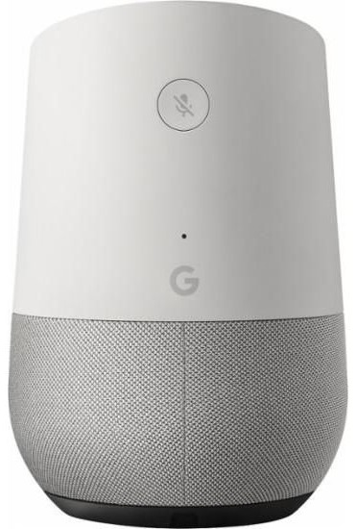



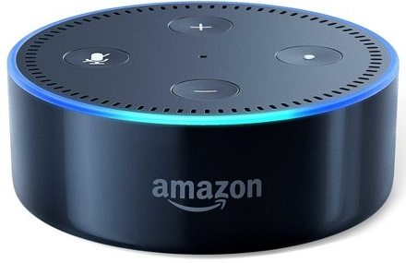



T4: Programmer Bot
P1
P2
P3
P4
ProBot
Developer
Best code
example
+
Notes:
Another plain I have to develop a programmer bot.
It will accept a natural language query from developer JOE and return a high quality relevant code.
Now, in the background, this will happen.
First query will be translated into search engine friendly query with relevant API classes and thousands of examples will be collected.
Then we will use some to determine the best quality code example.
Now, I did figured out this part. sophisticated machine learning
The rest part is still pending and hope to get it done by some brilliant grad students.

Slide 51
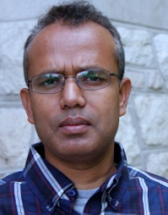
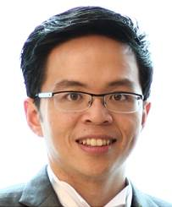
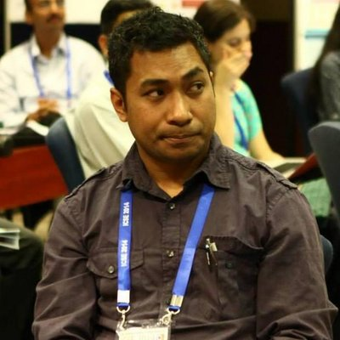
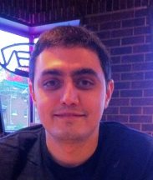
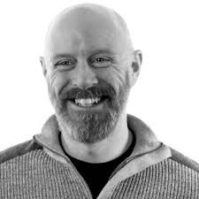
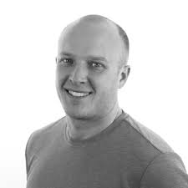
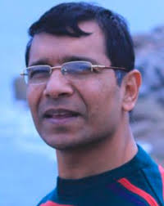

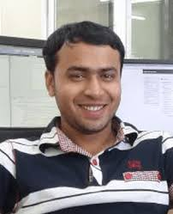
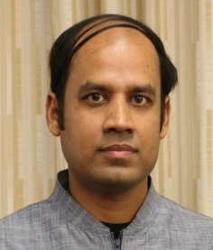





Research Collaborations
P1
P2
P3
P4
Chanchal Roy
David Lo
Raula Kula
Iman Kievanloo
Jason Collins
Jesse Redl
A. S. M. Arif
Shamima Yeasmin
Amit Mondal
Saikat Mondal
Rodrigo Silva
Notes:
Over the years, I worked with experts from my domain, and learned from the bests.
I worked with academia as well as industry.
For example, Vendasta is a leading company based in Saskatoon, and we got our NSERC Industry Engage grant in collaboration with them.
So my since thanks and gratitude to all the collaborators.

Slide 52










Major Research Achievements
P1
P2
P3
P4
DPA Nomination
(ICSME 2018)
Keith Geddes
Award 2017, U of S
President Gold Medal,
Bangladesh
ACM CAPS
Award 2017
Flagship SE venues
Google Scholar: 29/301, H-Index: 9
Notes:
Now, these are some achievements of my work.
Got several competitive awards over the last few years.
Got funding from NSERC. Thanks U of S and my professor for all the support.
Also got accepted in the flagship conferences/journals such ICSE, FSE, ASE and EMSE

Slide 53
P1
P2
P3
P4
Part IV: Q&A
Masud Rahman
http://www.usask.ca/~masud.rahman
https://github.com/masud-technope
Contact: masud.rahman@usask.ca
@masud2336
Notes:
Thanks for your time and attention.
Now, I am ready to take your questions.

Slide 55
P1
P2
P3
P4
S1
S2
S3
S4
S5
S6
STRICT
Search Query Reformulation for Concept Location using Graph-based Term Weighting
[SANER 2015 + 2017]

Slide 56

Quiz Test: Queries from a Change Request
P1
P2
P3
P4
S1
S2
S3
S4
S5
S6
Title
ID | Query | QE
1. | Custom search results view iresource
2. | Custom search results search results view
3. | element iresource provider level tree
4. | Custom search results hierarchically java search results
1331
636
01
570
Description
88%
~11K documents
Notes:
Let us see an example.
This is a bug report, this is title and this is the description.
Now, developer JOE would use this bug report to localize the bug from source code.
Now he chose some ad hoc queries.
Which one is the best do you think, here? PAUSE!
Well, lets see. This one returns the correct result at this position. That means, the developer needs to check 1300+ results b4 reaching to the correct result he tries this query.
… oh… this one is the best.
So, selecting appropriate keywords from the bug report is not that simple.

Slide 57


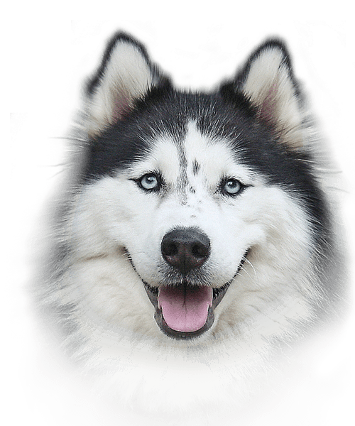
TF-IDF: Term Importance (Traditional)
P1
P2
P3
P4
S1
S2
S3
S4
S5
S6
University of Saskatchewan
The Saskatchewan Huskies football team represents the University of Saskatchewan in U Sports football that competes in the Canada West Universities Athletic Association conference of U Sports. The program has won the Vanier Cup national championship three times, in 1990, 1996 and 1998.
The Saskatchewan Huskies became only the second U Sports team to advance to three consecutive Vanier Cup games, after the Saint Mary's Huskies, but lost all three games from 2004-2006. The team has won the most Hardy Trophy titles in Canada West, having won a total of 20 times. The 2006 Saskatchewan Huskies became only the third team to play in a Vanier Cup that their school was hosting, when the University of Saskatchewan hosted the 42nd Vanier Cup. The Toronto Varsity Blues were the first when they won two Vanier Cups in 1965 and 1993. Saskatchewan also became the first western school to host the national championship game.
TF
IDF
TF x IDF
Saskatchewan:6
Vanier: 5
Won: 4
Huskies: 4
Cup: 4
Team: 4
Sports: 3
Times: 2
School: 2
Championship:2
Saskatchewan: .01
Vanier: 0.1
Won: 0.1
Huskies: 0.1
Cup: 0.01
Team: 0.01
Sports: 0.02
Times: 0.03
School: 0.05
Championship: .03
Vanier: 0.5
Won: 0.4
Huskies: 0.4
School: 0.1
Saskatchewan: 0.06
Championship: 0.06
Sports: 0.06
Times: 0.06
Cup: 0.04
Team: 0.04
Saskatchewan Huskies
IDF = log (DF / N)

Slide 58
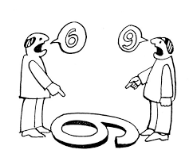


Take-Home Messages
P1
P2
P3
RQ1
TF-IDF
PageRank
Thesis
WordNet
Equality
RQ2
RQ3
Stack Overflow
Equity
FastText

Slide 59








Experiment, Dataset & Metrics
P1
P2
P3
P4
S1
S2
S3
S4
S5
S6
310 Queries & Ground truth
Hit@K
MAP@K
MRR@K
MR@K
QE
NDCG
Java2s
CodeJava
769K Code segments
Notes:
For the API suggestion, we natural language queries from four tutorial sites such as KodeJava and others.
We collect 300+ queries, we also collect the ground truth API classes from them.
Then we try to determine our approach can suggest appropriate API classes for those queries by mining crowd knowledge from Stack Overflow.
For the query reformulation part, we collect 4K code examples from GitHub, combine with our ground truth code segments from tutorial site.
Then we determine whether our reformulated query actually works or not.

Slide 60
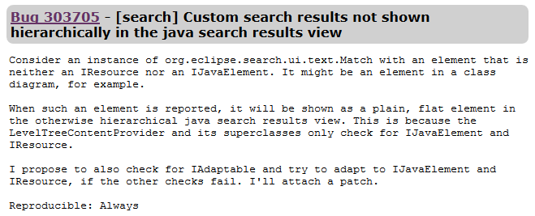
What is a Good Search Query?
P1
P2
P3
P4
S1
S2
S3
S4
S5
S6
Title
Correct
Result
Correct
Result
Description
Correct
Result
Worse Query
Baseline Query
(Title + Description)
Better Query
Notes:
Now let me explain the metrics a bit since we will be using these a lot.
Hit@K is the percentage of the queries for which at least one ground truth is found within the top K results.
MAP is the standard precision + result position. The detailed is much complex which I can discuss later.
MRR is the inverse of the rank of first ground truth within the result.
QE also stands for query effectiveness is just the opposite of MRR

Slide 61
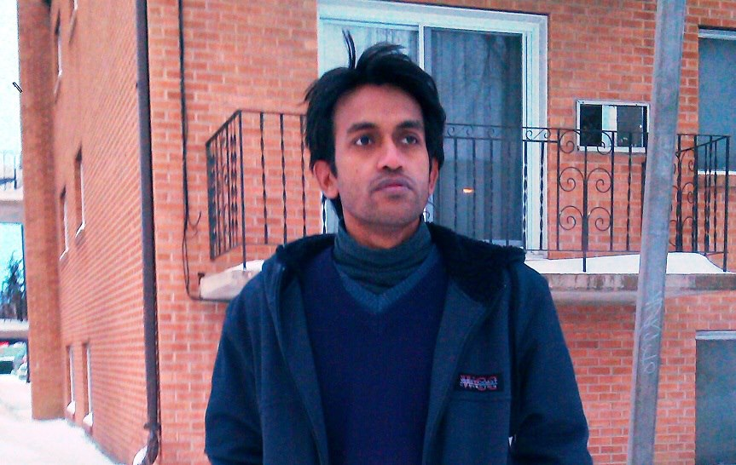

About Me
2012
Me
Software Research Lab
Notes:
So, Who am I?
I came to Canada back in 2012 as a young graduate student. This the first winter.
I got these two lovely young ladies by my side 24/7.
I am a member of Software Research Lab, University of Saskatchewan.
I work with Dr. Chanchal Roy.
We got a pretty big group there, and do a lot of stuffs besides research.

Slide 62

Masud Rahman: Academics
2019
PhD Candidate,
University of Saskatchewan
(Award: Dr. Keith Geddes Award)
2014
MSc, University of Saskatchewan
(Award: Best MSc Thesis Nomination)
2009
BSc, Khulna University, Bangladesh
(Award: President Gold Medal)
Notes:
A little bit of background about Me:
Currently, I am a PhD Candidate at USASK.
I completed my MSc in Software Engineering from the same university in 2014.
Before that, I completed my BSc in Computer Science & Engineering from Khulna University, back in 2009.

Slide 63
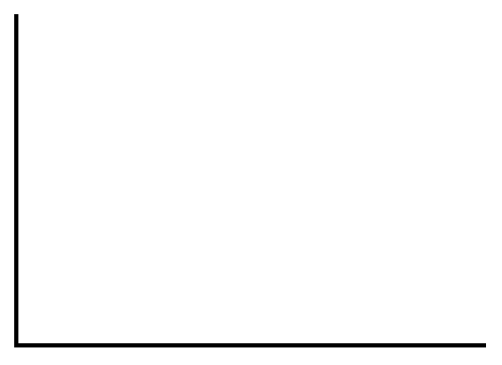
Semantic Hyperspace
P1
P2
P3
S1
S2
S3
S4
S5
S6
x
P (1, 5, 6, 7, ….., N)
y
P (2, 4, 6, 9, ….., N)
y = mx + c,
x^2 +y^2 = r^2
ax^2+bx+c=0
y
Notes:
Here we see that burger is close sandwich. Why? They are eaten together. I do that all the time.
Well, that is not the case.
They are mentioned in the similar contexts by the people across the whole corpus.
The model recognizes such occurrences and thus put burger and sandwich close together.
Similarly, dumpling and ramen are close to each other.
Now, we propose this. This is original query, and this is reformulated query.
Now, a good reformulated query will cluster together the original query.
A bad reformulated query will NOT be able to cluster with the original query.
So, clustering tendency within the hyperspace is our weapon here.
We calculated Hopkins statistic and Polygon Area for calculating the clustering tendency.

Slide 64
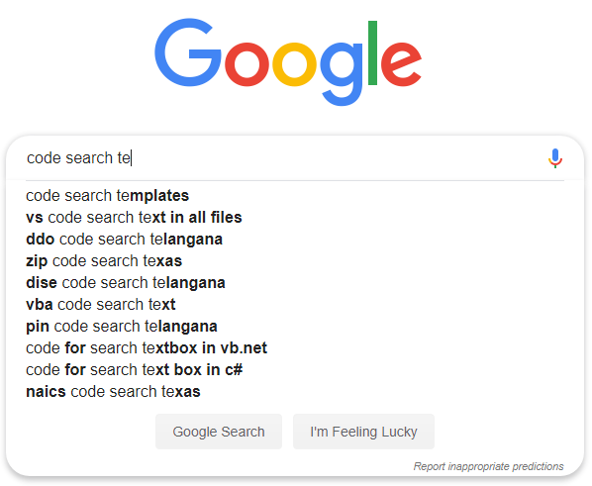

Two Working Contexts: Local & Global
P1
P2
P3
Boeing
codebase
GitHub
Local code search
(e.g., bug localization)
Internet-scale
code search
Notes:
Now lets expand and generalize the problem a bit.
So far, we discuss the code search within a local codebase.
It could also be in the large-scale open source repository such as GitHub.
Now, based on these contexts, there are different challenges in query reformulation.
The local codebase is small, domain specific and organized.
On the contrary, GitHub is huge, cross-domain and very noisy.
So, yes, they need different strategies to suggest queries for them.

Slide 65
S2: Keywords Selection from Source Code with CodeRank
P1
P2
P3
S1
S2
S3
S4
S5
S6
resolveRuntimeClasspathEntry
Resolve Runtime Classpath Entry
RQ1 [Source Code]: Keywords selected by PageRank are more effective for local code searches (e.g., concept location) than that of TF-IDF
Notes:
Now once such items are extracted, we split them.
Now as we see, these single terms share some kind of semantics to convey a broader semantic.
That is, they complement each other in this context.
Now, we capture such semantic dependencies in the source code, and develop a term graph like this.

Slide 66

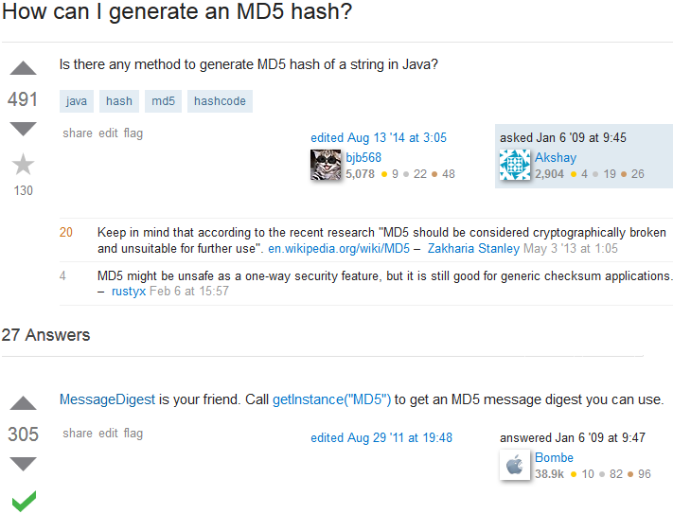

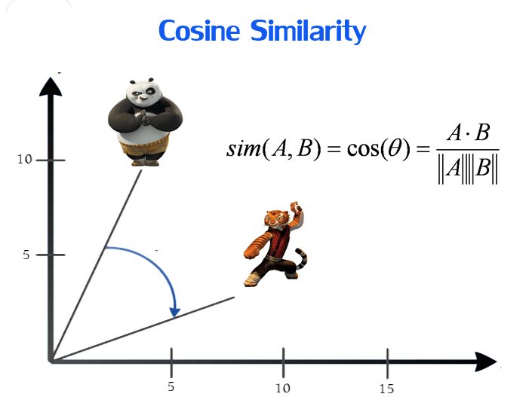
How did we Do?
P1
P2
P3
S1
S2
S3
S4
S5
S6
3
RQ3: Appropriate query keywords can be delivered for the code search using Stack Overflow and FastText.

Slide 67


R3: Solve Vocabulary Mismatch Issue
P1
P2
P3
P4
Customer
Past
Developer
15%
15%
Codebase
Bug Report
Developer
Notes:
That is, each of three people, customer, past developer and JOE have their own vocabulary to describe a certain problem/concept.
In fact, any people will discuss the same problem with the same vocabulary, this probability is only 15%-20%
So, naturally, developer JOE finds it a great challenge to make a connection between bug report and the buggy code.
This costs development time, money and valuable efforts.

Slide 68



Solution: Semantic Hyperspace
P1
P2
P3
P4
Word 1
P (1, 5, 6, 7, ….., N)
Cosine distance = Semantic relevance
Word 2
P (2, 4, 6, 9, ….., N)
Word 2
Notes:
Here we see that burger is close sandwich. Why? They are eaten together. I do that all the time.
Well, that is not the case.
They are mentioned in the similar contexts by the people across the whole corpus.
The model recognizes such occurrences and thus put burger and sandwich close together.
Similarly, dumpling and ramen are close to each other.
Now, we propose this. This is original query, and this is reformulated query.
Now, a good reformulated query will cluster together the original query.
A bad reformulated query will NOT be able to cluster with the original query.
So, clustering tendency within the hyperspace is our weapon here.
We calculated Hopkins statistic and Polygon Area for calculating the clustering tendency.

Slide 69
R4: Genetic Algorithm for Queries
P1
P2
P3
P4
Title
Description
Fitness Function
Method | Search Query | QE
Baseline | {title + description} | 25
STRICT[140] | {tab classpath enabled buttons user entry} | 86
TF-IDF | {button entry bootstrap enabled incorrectly moving} | 177
GA | {open reflect tab bottom entry classpath} | 01
Lower QE is better

Slide 70


Search Query from Noisy Bug Report
P1
P2
P3
S1
S2
S3
S4
Bug 31637 – should be able to cast null
NullPointerException
C_{i}
C_{j}
M_{k}
M_{n}
C_{p}
53
01
Notes:
So, from a noisy report, we extract
The report title
The encountered exception
The most important keywords from the stack traces.
Then we do the search with this newly constructed query.
For example, the baseline noisy query returns the result at 53rd position.
Whereas our query returns the correct result at the topmost position.

Slide 71



Dice, Rocchio, RSV

Slide 72
Vocabulary Mismatch Problem
P1
P2
P3
Both are correct and wrong!
Boeing
Customer
15%
Boeing
Developer
Notes:
Now the question is, why is this so challenging?
The answer is vocabulary mismatch problem. In fact, this is a common problem for any type of document search.
Here we see both guys are looking at the same object, but they are explaining it differently.
That is, they are both correct from their perspective, but wrong from other guy’s perspective.
This also actually happens with bug reports as well.
Both customer and developer will explain the same problem using the same terminologies, that probability is only 15%
That is why selecting appropriate keywords from the bug report is very challenging.

Slide 73
Keywords from a Bug Report
P1
P2
P3
Title
ID | Query | QE
1. | Custom search results view iresource
2. | Custom search results search results view
3. | element iresource provider level tree
4. | Custom search results hierarchically java search results
1331
636
01
570
Description
Lower QE is better
Notes:
Let us see an example.
This is a bug report, this is title and this is the description.
Now, developer JOE would use this bug report to localize the bug from source code.
Now he chose some ad hoc queries.
Which one is the best do you think, here? PAUSE!
Well, lets see. This one returns the correct result at this position. That means, the developer needs to check 1300+ results b4 reaching to the correct result he tries this query.
… oh… this one is the best.
So, selecting appropriate keywords from the bug report is not that simple.

Slide 74


Probabilistic Term Weighting
KLD

